Slide 1
Introduction to Statistical Data Analysis and Machine Learning
Matteo Biagetti & Tommaso Rodani
Trieste, 22/10/2024

Slide 2

Outline
Why a data analysis course at MDMC?
Objectives of the course
Topics of the course
Your data

Slide 3
Why data analysis at MDMC?

Slide 4
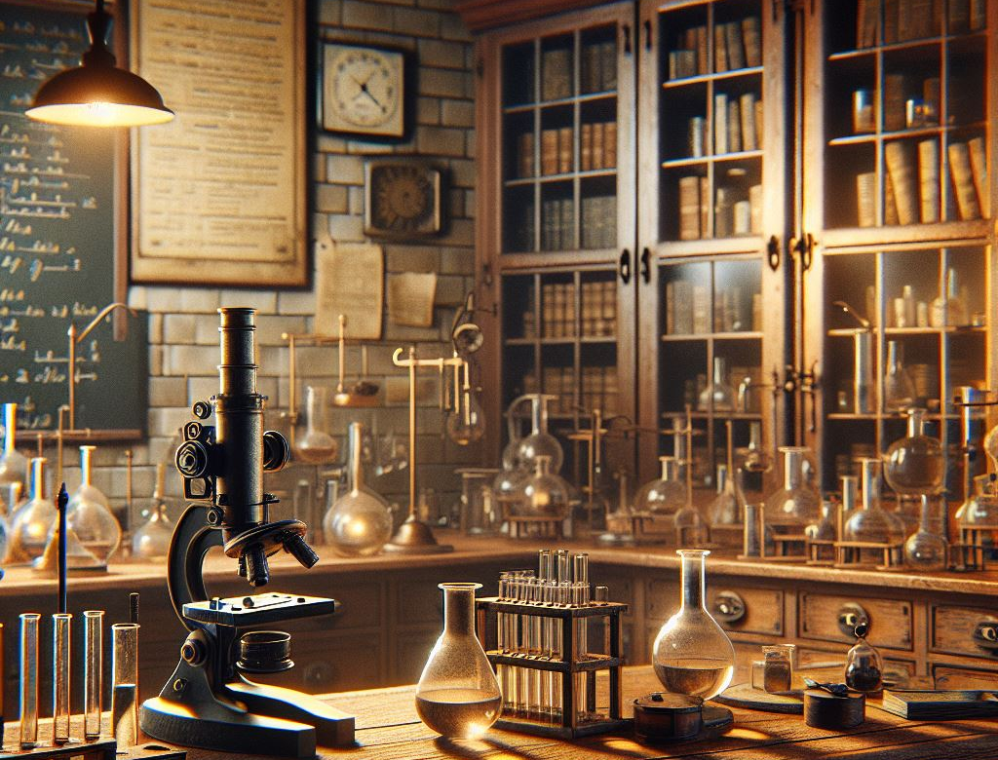
Why data analysis at MDMC?
Research Lab
Generated with AI
Notes:
Good afternoon. In the next 10 minutes I want to show you how I want to try to unveil one of the biggest mysteries in all science: what happened at the beginning of time? I will tackle this challenge by extracting information about the very early universe from the observation of the sky.

Slide 5
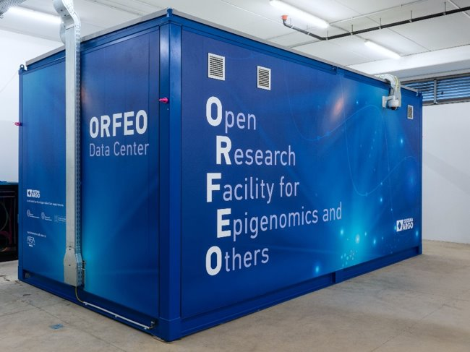
Why data analysis at MDMC?
Research Lab
FAIRification: data and metadata acquisition procedure compliant with FAIR principles
Generated with AI
Notes:
Good afternoon. In the next 10 minutes I want to show you how I want to try to unveil one of the biggest mysteries in all science: what happened at the beginning of time? I will tackle this challenge by extracting information about the very early universe from the observation of the sky.

Slide 6
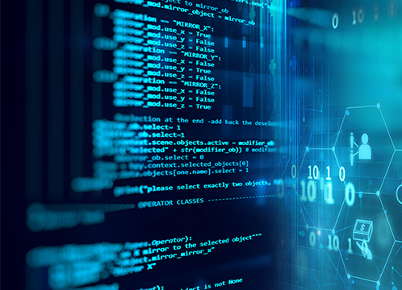
Why data analysis at MDMC?
Automatisation: Unsupervised data and metadata handling and pre-processing
Research Lab
FAIRification: data and metadata acquisition procedure compliant with FAIR principles
Generated with AI
Notes:
Good afternoon. In the next 10 minutes I want to show you how I want to try to unveil one of the biggest mysteries in all science: what happened at the beginning of time? I will tackle this challenge by extracting information about the very early universe from the observation of the sky.

Slide 7
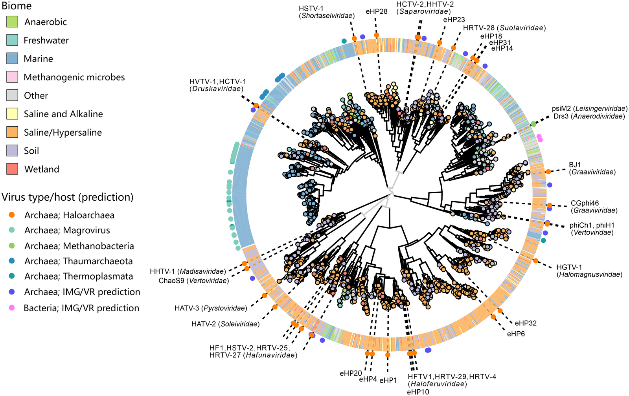
Why data analysis at MDMC?
Automatisation: Unsupervised data and metadata handling and pre-processing
Data-driven approach:
Innovation through interdisciplinary research
Research Lab
WikiMedia Commons
FAIRification: data and metadata acquisition procedure compliant with FAIR principles
Generated with AI
Notes:
Good afternoon. In the next 10 minutes I want to show you how I want to try to unveil one of the biggest mysteries in all science: what happened at the beginning of time? I will tackle this challenge by extracting information about the very early universe from the observation of the sky.

Slide 8
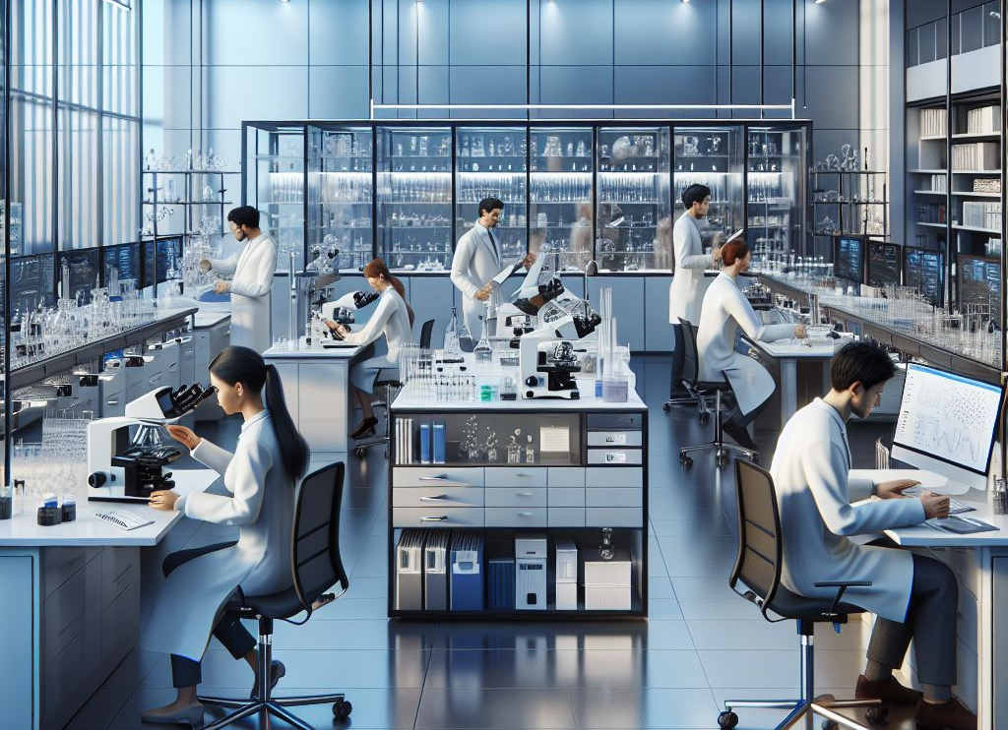
Why data analysis at MDMC?
Automatisation: Unsupervised data and metadata handling and pre-processing
Data-driven approach:
Innovation through interdisciplinary research
FAIR Research Lab
WikiMedia Commons
FAIRification: data and metadata acquisition procedure compliant with FAIR principles
Infrastructure-Augmentation:
Data and metadata analysis suggests improvements to the lab itself
Generated with AI

Slide 9
Objectives
Suppose you have spent some effort to build a data workflow in your lab so that data and meta data are managed in a proper (FAIR) way.
Now what?
What type of information do these data and metadata contain?
Can they be preprocessed to simplify information extraction?
What tools can I use to extract information?
Problem Identification
Problem Investigation
Problem Solution
Notes:
Good afternoon. In the next 10 minutes I want to show you how I want to try to unveil one of the biggest mysteries in all science: what happened at the beginning of time? I will tackle this challenge by extracting information about the very early universe from the observation of the sky.

Slide 10
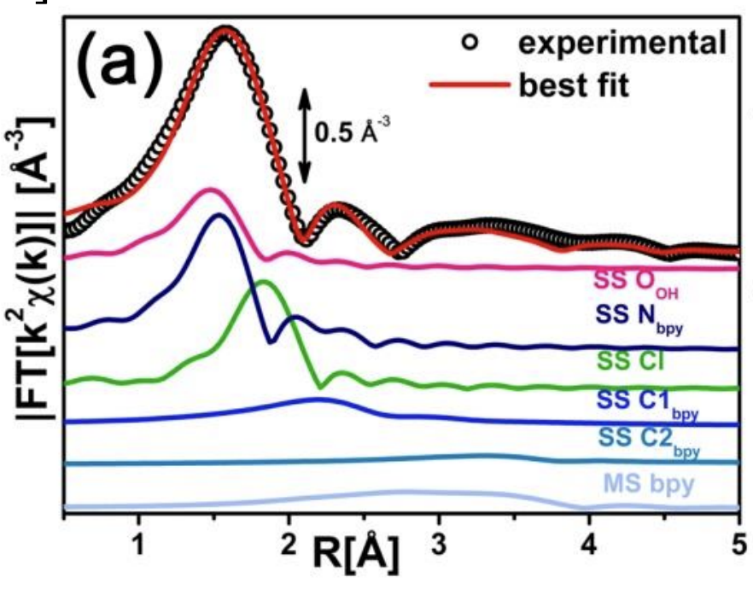
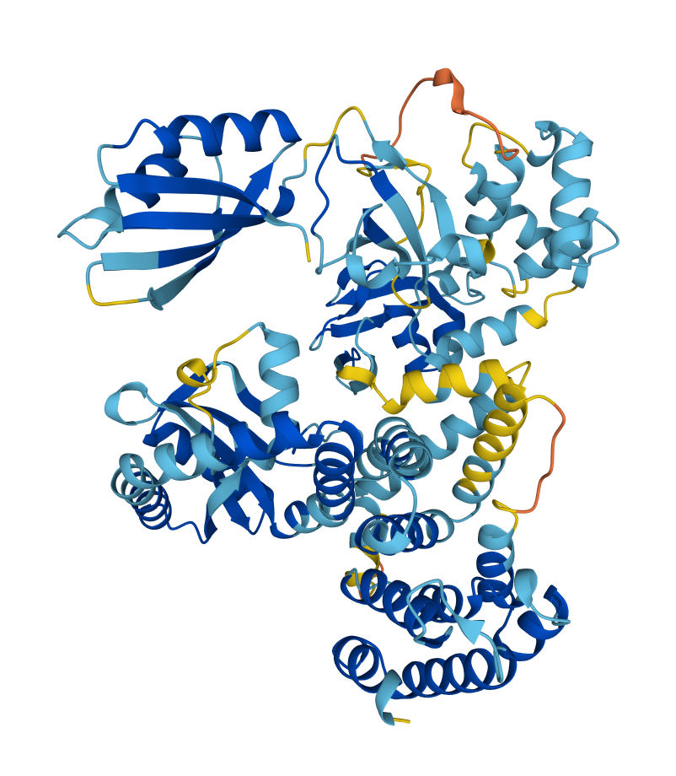
Topics
1. REGRESSION
Given an input-output pair, I want to learn the relation between the two
To predict a new output given a new input
To learn the physical, biological, chemical, etc, law between input and output
To generate a new pair
…
Braglia et al. 2017
AlphaFold (DeepMind)
WikiMedia Commons
Notes:
Good afternoon. In the next 10 minutes I want to show you how I want to try to unveil one of the biggest mysteries in all science: what happened at the beginning of time? I will tackle this challenge by extracting information about the very early universe from the observation of the sky.

Slide 11
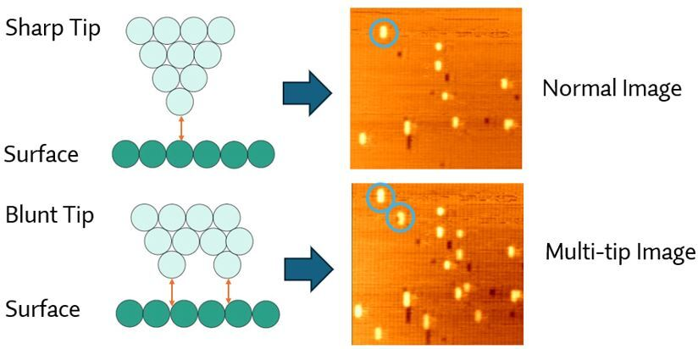
Topics
2. CLASSIFICATION
Given set of data with given properties, I want to classify them based on these properties
To single out specific properties
To filter data for purification
…
Figure by Tommaso Rodani
Notes:
Good afternoon. In the next 10 minutes I want to show you how I want to try to unveil one of the biggest mysteries in all science: what happened at the beginning of time? I will tackle this challenge by extracting information about the very early universe from the observation of the sky.

Slide 12
Topics
3. UNSUPERVISED LEARNING
Given set of data, I want to discover its properties
To discover relations among quantities (new physical, biological, chemical laws)
Reduce dimension of dataset
…
Notes:
Good afternoon. In the next 10 minutes I want to show you how I want to try to unveil one of the biggest mysteries in all science: what happened at the beginning of time? I will tackle this challenge by extracting information about the very early universe from the observation of the sky.

Slide 13
Your Data!
Notes:
Good afternoon. In the next 10 minutes I want to show you how I want to try to unveil one of the biggest mysteries in all science: what happened at the beginning of time? I will tackle this challenge by extracting information about the very early universe from the observation of the sky.

Slide 14


Nano Foundries Fine Analysis Digital Infrastructure
Pathogen Readiness Platform for CERIC-ERIC Upgrade
This Pilot training activity has been funded by the European Union – NextGenerationEU within the project PNRR "PRP@CERIC" IR0000028 and «NFFA-DI" IR0000015 - Missione 4, “Istruzione e Ricerca” – Componente 2, “Dalla ricerca all'impresa” – Linea di investimento 3.1, “Fondo per la realizzazione di un sistema integrato di infrastrutture di ricerca e innovazione” – Azione 3.1.1, “Creazione di nuove IR o potenziamento di quelle esistenti che concorrono agli obiettivi di Eccellenza Scientifica di Horizon Europe e costituzione di reti”.

